Slide 1
Scalable Forecasting with Webpage Views
By: Eric Patterson

Slide 2
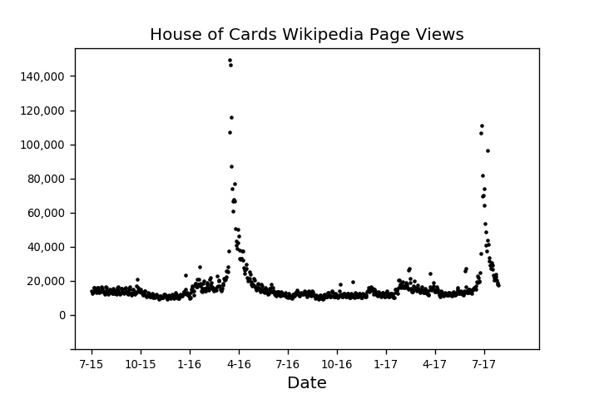
Process
Gather Data

Slide 3
Process
Automate process for scale
Gather Data
Model data manually
Scale model using Amazon Lambda

Slide 4
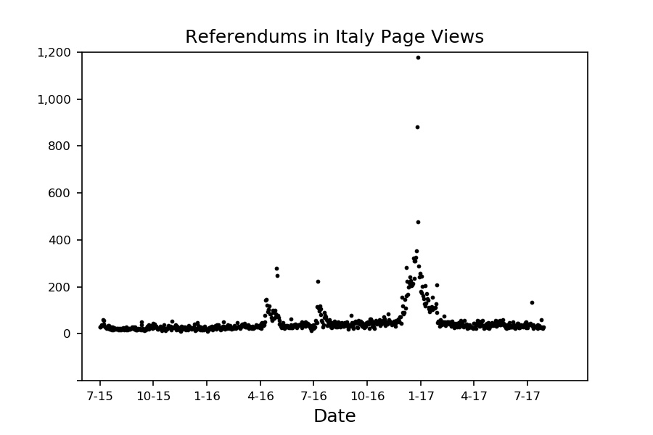
Manual Forecasting

Slide 5
Manual Forecasting

Slide 6
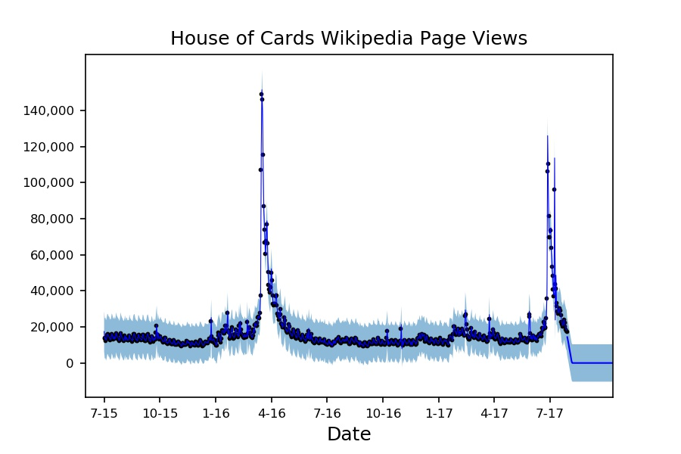
Manual Forecasting

Slide 7
Manual Forecasting

Slide 8
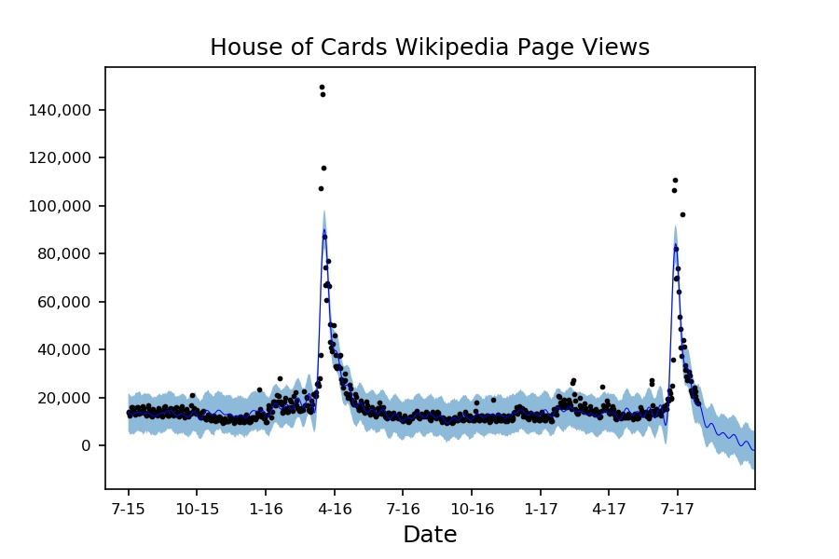
Manual Forecasting

Slide 9
Manual Forecasting

Slide 10
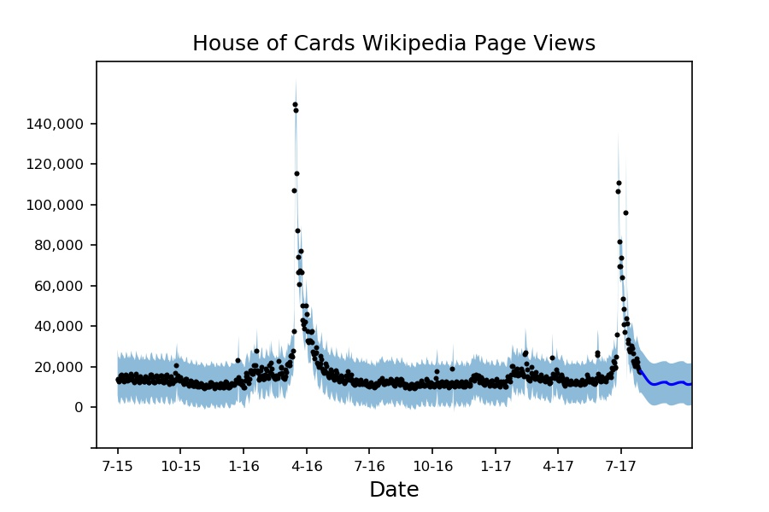
Manual Forecasting

Slide 11
Manual Forecasting

Slide 12
Process Automation
odel data manually

Slide 13
Process Automation
Feature Selection: Create a rules set

Slide 14
Process Automation
Feature Selection: Create a rules set
Model Selection: Test each fit on a test set

Slide 15
Process Automation
Feature Selection: Create a rules set
Model Selection: Test each fit on a test set
Scale using pipeline on AWS

Slide 16
AWS Pipeline Architecture

Slide 17

AWS Pipeline Architecture
S3 Source Bucket

Slide 18

AWS Pipeline Architecture
S3 Source Bucket
Lambda Function

Slide 19

AWS Pipeline Architecture
ARIMA Model
Prophet Model
S3 Source Bucket
Lambda Function
XgBoost Model

Slide 20
AWS Pipeline Architecture
Prophet Model
S3 Source Bucket
Lambda Function

Slide 21
AWS Pipeline Architecture
Prophet Model
S3 Source Bucket
Lambda Function
Destination Bucket

Slide 22
Summary of Findings
Model use summary:
56% Arima
27% Xg Boost
17% Prophet
29% average MSE Reduction over single model forecasting

Slide 23
Scalable Modeling Applications
Automated Reporting
Sales Forecasting
Anomaly Detection

Slide 24

Thank You
Eric Patterson
LinkedIn: e-patterson
Github: Leaferickson
Twitter: I don't believe in it

Slide 25
Scaling using AWS
ARIMA Model
Prophet Model
S3 Source Bucket
Lambda Function
Destination Bucket
XgBoost Model

Slide 26
Scaling using AWS
ARIMA Model
Prophet Model
S3 Source Bucket
Lambda Function
Destination Bucket
XgBoost Model

